Slide 1
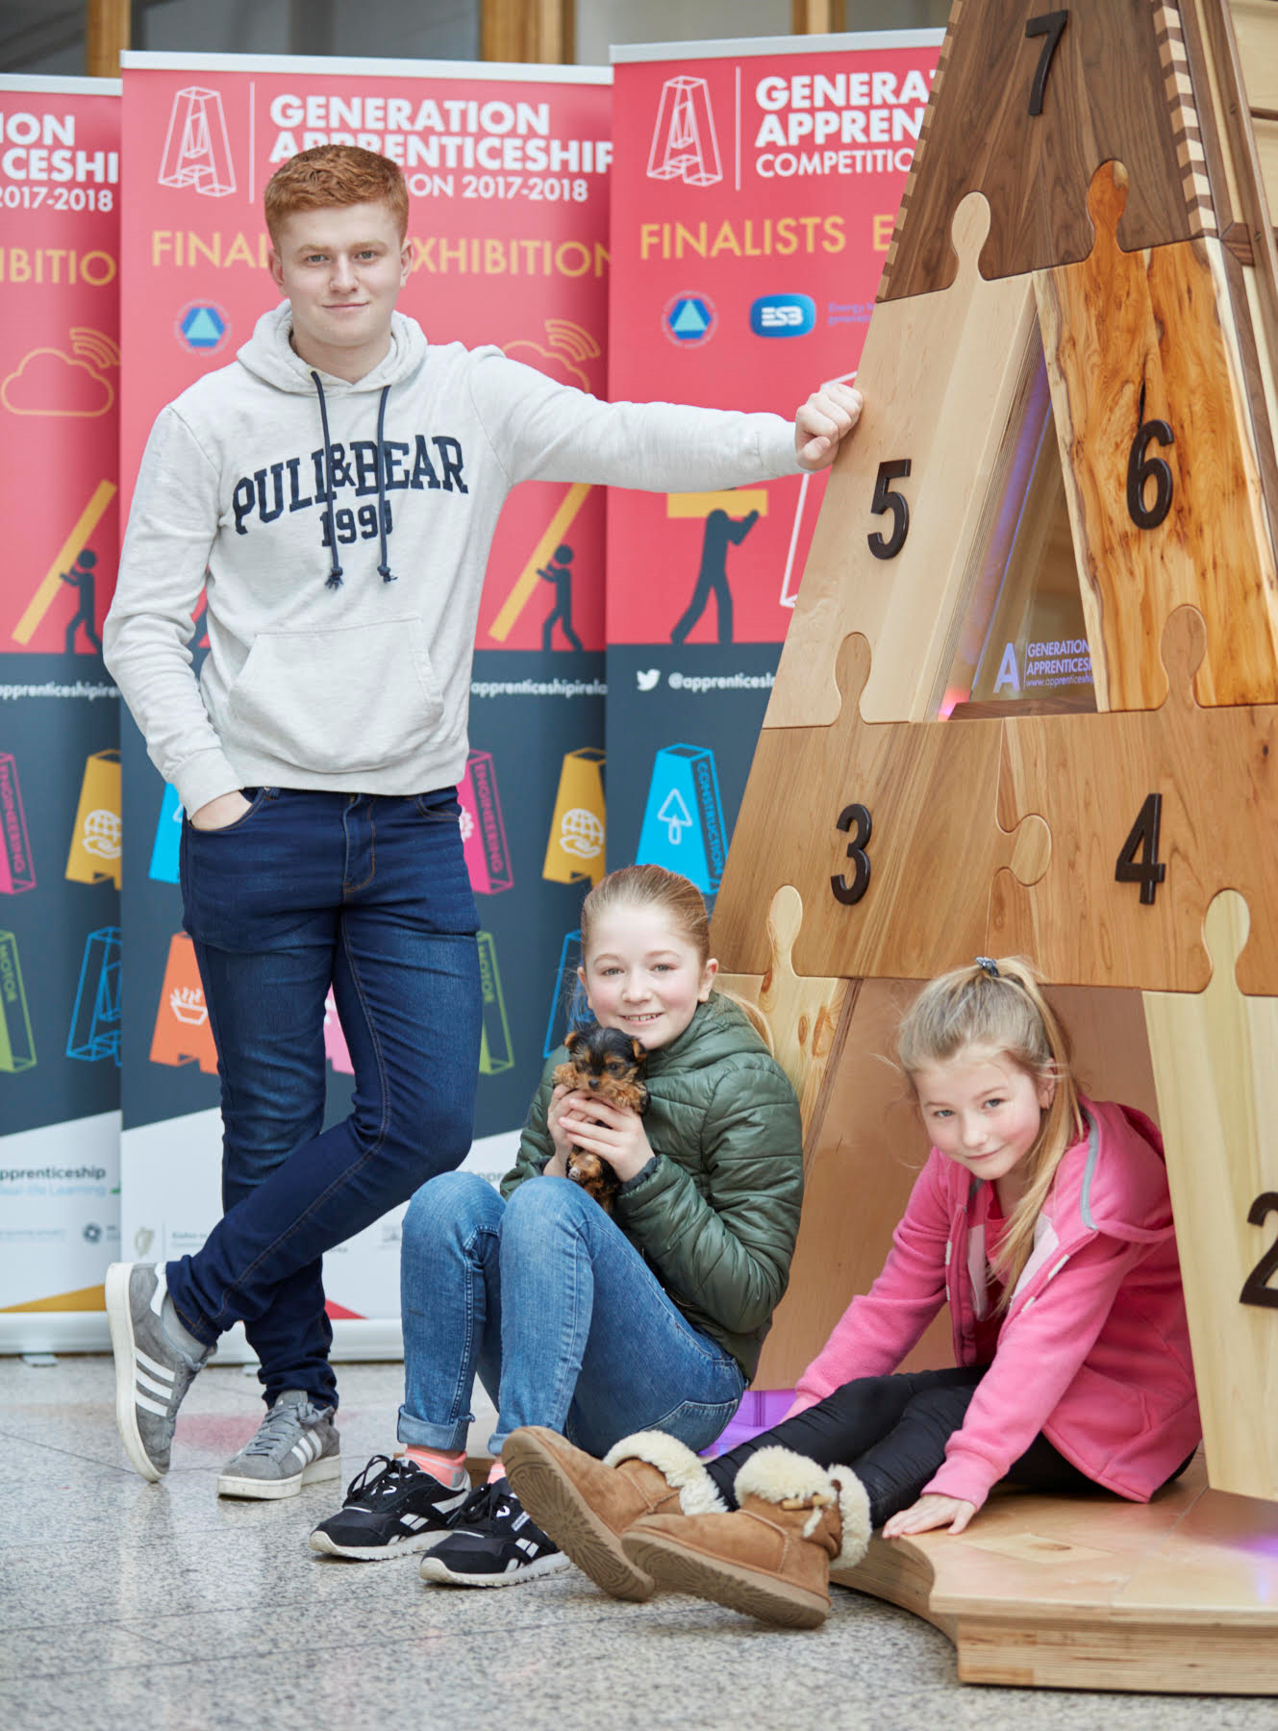
Some thoughts for discussion on ‘where FE met HE’
Workshop 2, TUI Education Reform conference November 2019
Dr Mary-Liz Trant, Executive Director

Slide 2
Two questions up front:
To an external person, how would we characterise the current state of the further and higher education relationships within Irish ‘tertiary education’?
Who are our leaders in developing the tertiary education community?

Slide 3
Current state of further and higher education in Ireland, EU, internationally
3 drivers of change
Where are we heading? Opportunities and risks
The leadership challenge

Slide 4
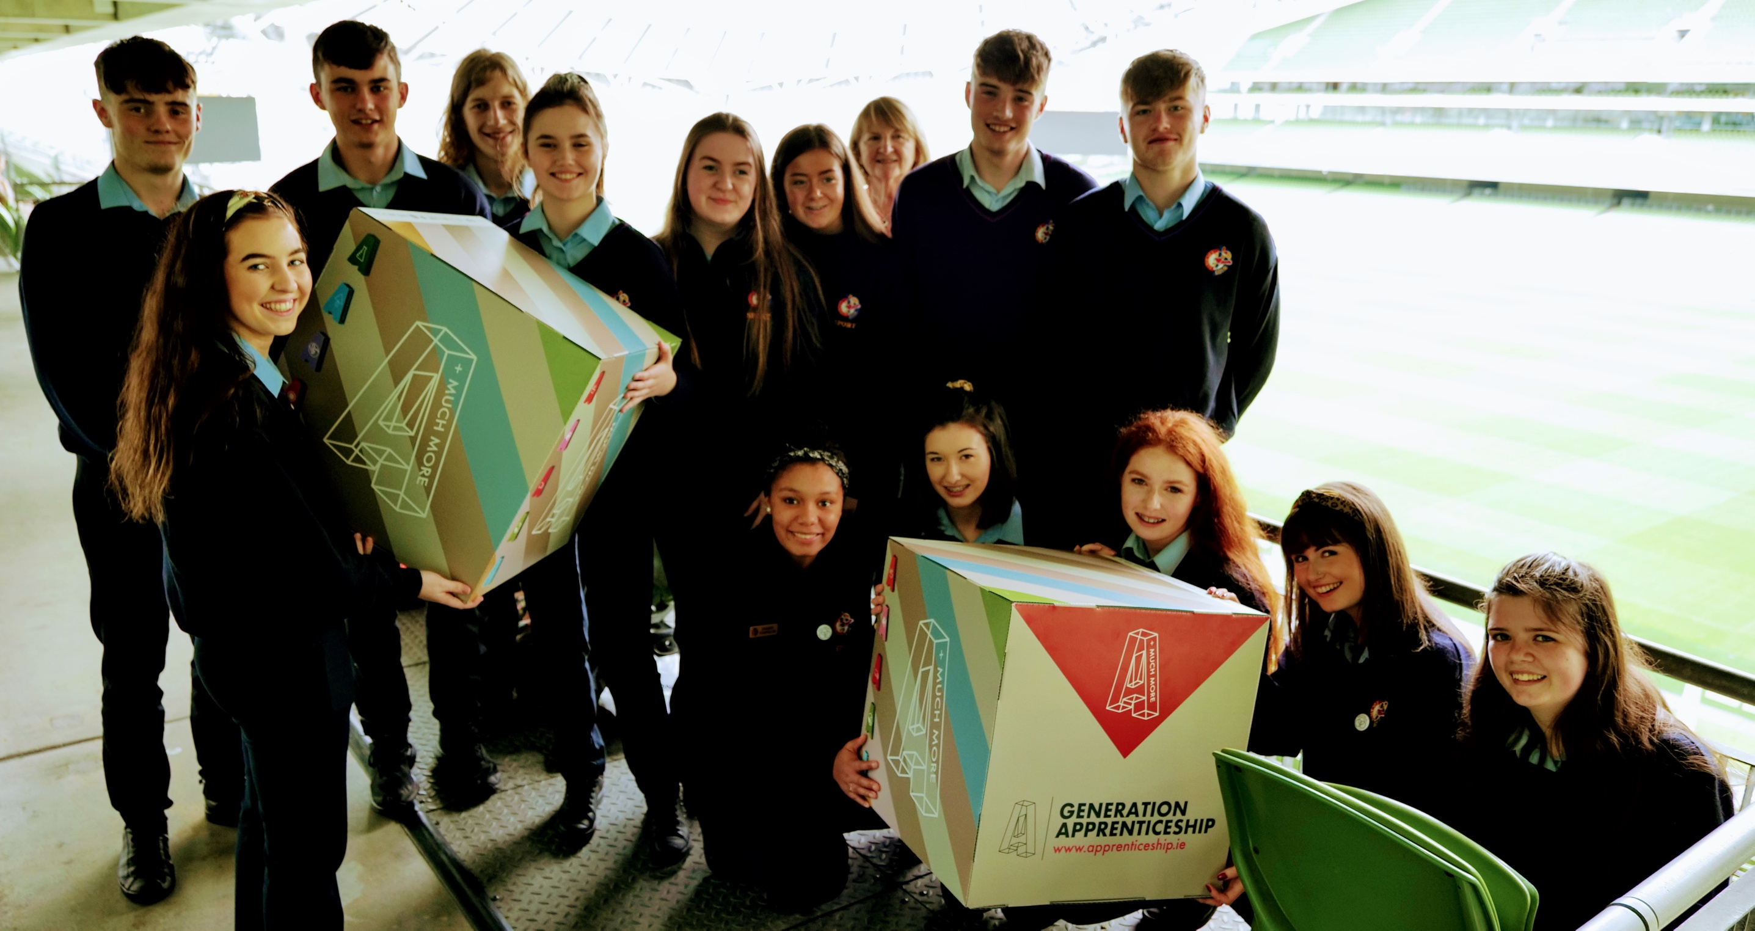
To an external person, how would we characterise the current state of the further and higher education relationships within Irish ‘tertiary education’?
Who are our leaders in developing the tertiary education community?

