Slide 1
Positive Mental Health
Shane Moran
Counselling Psychologist

Slide 2


Slide 3
What has president Donald trump got to do with positive mental health?
The Answer:
Every and Nothing

Slide 4
So what is positive mental health?
Is it being happy?
Is it being Content?
Is it being free from stress and worry?
Is it about being successful?
“Show me a sane man, and I will cure him for you”
Carl Yung

Slide 5
What does positive mental health mean to you?
Do you believe that you have positive mental health?
I imagine that most of you present here today would consider yourselves successful in your own professional careers!
Yet
Some here may suffer from poor mental health!

Slide 6
The comedian Rita May Brown once stated:
“The statistics on sanity are that one out of every four people is suffering from a mental illness. Look at your three best friends. If they’re okay, then it is you”

Slide 7
There are three challenges
First, is defining ‘positive mental health’?
Second, is does it exist or is it pure illusion?
Third, is it achievable?

Slide 8
To Search
If we view mental health as a search for happiness then the destination of this quest is indeed an illusion.
The reality is, there is no nirvana, no promised land, no enlightenment, just pure illusion.
“The path to happiness starts from an understanding of the roots causes of suffering”
The Buddha

Slide 9
“You will never be happy if you continue to search for what happiness consists of. You will never live if you are looking for the meaning of life”
Albert Camus

Slide 10
ILLUSION AND WELLBEING
Many Psychologist would put forward the view that accurate perceptions of the self, the world, and the future are essential for mental health.

Slide 11
It is worth noting however, that those people who suffer from depression and anxiety, tend to have a more realistic view of themselves in the context of their view of the world?
Paradoxically
It is those who are perceived by others to have good PMH are the ones that have built a solid illusion around themselves, in a sense distorting reality, therefore avoiding negativity and anything that might threaten their view of the world

Slide 12
from the field of educational psychology
The Fixed mind mentality
Versus
Growth mind mentality
Dr Carol S. Dweck

Slide 13
Yet, we are informed that the psychologically healthy person is one who maintains close contact with reality. There seems to be a contradiction here.
Look at the world of the ‘Hello magazine’ and the view presented of happy, successful people or that is what we are told.
Take a closer look at this illusion and the truth is quite different.

Slide 14
Positive mental health an illusion?
“This life is a valley of tears” according to my Dad
No positivity there but perhaps realism?
You get what you get, and you make the best with the hand you have been dealt with…sometimes life is tough.
“Life is like a box of chocolates, you don’t know what you are going to get”
Forest Gump

Slide 15
Pause for thought
For my grandparents what was important for them was ensuring there was enough food on the table.
For my parents it was about ensuring they got a job.
For my generation it was the value of a good education.
For my children’s generation it is about good mental health and wellbeing.
You can’t have PMH with out the first three!

Slide 16
DEFINING MENTAL HEALTH
Mental health is a state of wellbeing in which the individuals realises his or her own abilities, can cope with the normal stresses of life, can work productively and fruitfully, and is able to make a contribution to his or her community.
(WHO, 2001)

Slide 17
Positive mental health
The value of being connected.
Belonging enables our survival.
What are these connections?
Union membership
Family
Nationality
Colleagues
Self knowledge

Slide 18
Wellbeing and school
The role of society
Aim of wellbeing in school, promoting the ‘growth mind’
Perceptions around published league tables, what’s the message here?

Slide 19
PMH IN EDUCATION
The story of wellbeing and where it is working
CSPE
SPHE
RSE
YSI
Debates
Sport

Slide 20
WELLBEING FOR TEACHERS AND MANAGEMENT
It needs to be acknowledged from the top down that teacher stress levels have increased. Generally speaking work-related stress has been identified as one of the largest problems in the EU working environment.
(Skalon, Nielson, Borg, & Guzman, 2010)

Slide 21
Job stress has been widely linked with adverse effects on employees psychological and physical wellbeing in many occupations especially those involved in education.
(Kinman & Jones, 2003)

Slide 22
‘The clouds that can surround a school’
PHM through the lens of a traumatic experience
The story of resilience of staff and student, and what it taught me!

Slide 23
The wedding story
&
Teacher of the Year Awards
“Someone is sitting in the shade today because someone planted a tree a long time ago”
Warren Buffett

Slide 24
How to build resilience
Resilience refers to an individual’s capacity to successfully adapt to change and stressful events in healthy and constructive ways
‘The bouncing ball effect’
How to make the ball bouncy?

Slide 25
“The ultimate measure of a man is not where he stands in moments of comfort and convenience, but where he stands at times of challenge and controversy”
Martin Luther King, Jr.

Slide 26
“Do not judge me by my success, judge me by how many times I fell down and got back up”
Nelson Mandela

Slide 27
The attributes of resilience
A sense of spirituality
Positive social skills
Family and social characteristics, e.g. connectedness & involvement in community
Ability to ‘accept and change’
Philosophy of Mindfulness (Lived)
Increase in a sense of control, meaning and decision making

Slide 28
How to increase resilience in young people
Provide young people with meaningful opportunities, there is a need to inspire them. (Young Americans)
Provide young people with resources and training to engage in opportunities.
Strengthen PMH and Wellbeing, by promoting self-worth, a sense of responsibility, autonomy, accountability, self-awareness, emotional competencies, membership and belonging and civic and social competence.

Slide 29
summary
PMH is a continuous journey, of ups and downs in our life
The value of a holistic approach to PMH, emphasising the responsibility of society.
The need to value the work undertaken by teachers and management.
Understand that wellbeing sometimes operates from top down.
Resilience is built and developed from experience, as we learn to accept and change

Slide 30
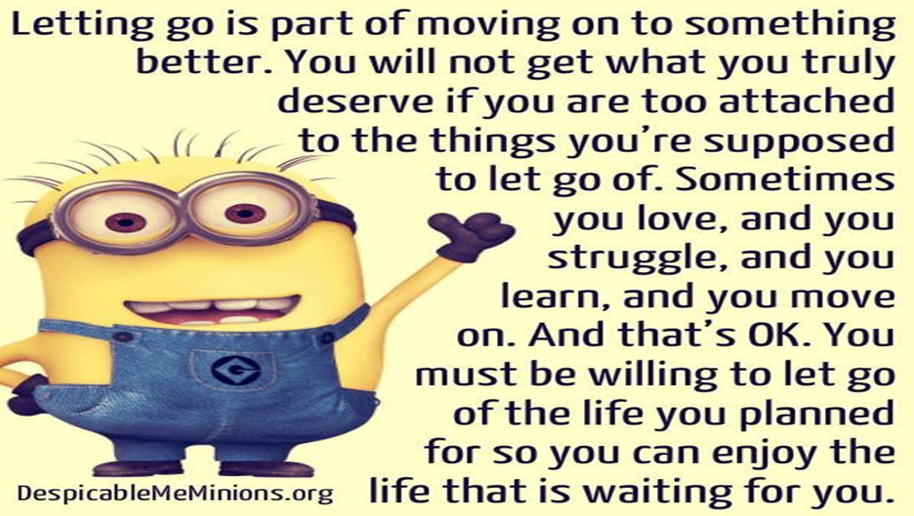

Slide 31
Shane Moran
Thank You for listening
Any Questions?

