Slide 1
Evaluating Provision for Students with Additional and Special Educational Needs in Post-Primary Schools
Briefing for the Education Partners
4th September 2018

Slide 2
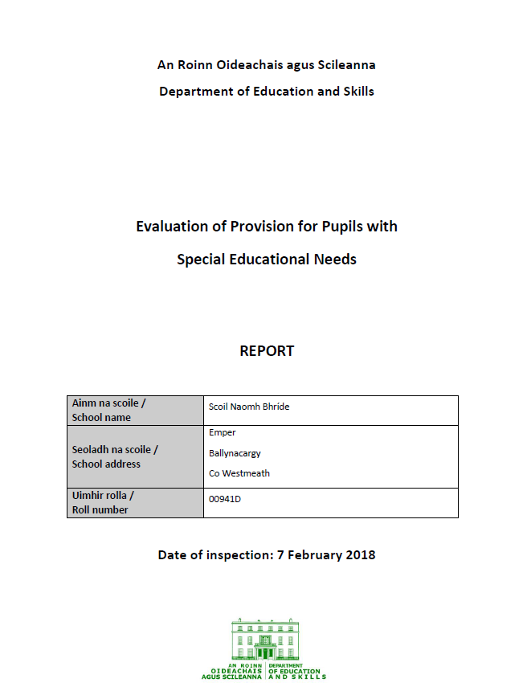
Context
Currently the Inspectorate evaluates provision for students with special educational needs in post-primary schools through the Subject Inspection model
We are developing a new evaluation model to reflect a number of different developments:
Introduction of resource allocation model
Publication of Guidelines for Schools
Increased emphasis on Continuum of Support
New evaluation model at primary level since 2016
Publication of Looking at Our School
Notes:
Introduction
Special Educational Needs is an important priority for the Government and for the Department:
It accounts for almost 1 in every 5 € spent by the Dept or just under 18% of entire DES budget –
It behoves us to ensure that provision is appropriate –
There is a need to review and improve existing practices

Slide 3
Focus of the SEN – PP model
The new model will address the following questions:
1. a. How good are the learning outcomes for students with additional and special educational needs?
1. b. How good are the learning experiences of students with additional and special educational needs?
2. How well is the school using the resources it receives for students with additional and special educational needs to improve learning experiences and learning outcomes?
3. How effective are the structures and systems that the school has in place in fostering the inclusion, equality of opportunity and holistic development of students with additional and special educational needs?
Notes:
Students with additional and special educational needs include:
students on stage one of the Continuum of Support who receive support within mainstream classes
students on stage two or stage three of the Continuum of Support who receive support within the mainstream classes and/or in support settings
students in special classes
Students for whom English is an Additional Language are included in this

Slide 4
Criteria based on Looking at Our School
How good are the learning outcomes for students with additional and special educational needs?
Do students:
enjoy their learning, are they motivated to learn, and do they expect to achieve as learners?
have the necessary knowledge and skills to understand themselves and their relationships?
demonstrate the knowledge, skills and understanding required by the post-primary curriculum?
attain the stated learning outcomes for each subject, course and programme?

Slide 5
Principles of resource allocation model aligned with Looking at Our School
Standard in Looking at Our School | Principle
Leading teaching and learning | Resources provided to support students with special educational needs should be used to facilitate the development of truly inclusive schools.
 | Supports provided to students with special educational needs should be based on identified needs and be informed by regular reviews of progress (in consultation with parents and students) as outlined in the Continuum of Support Guidelines.
 | The subject teacher has primary responsibility for the progress and care of all students in the classroom, including students with special educational needs

Slide 6
Principles of resource allocation model aligned with Looking at Our School
Standard in Looking at Our School | Principle
Managing the organisation | Special education teaching supports provided to schools should be used solely for the support of students with identified special educational needs, including those students for whom English is an Additional Language (EAL).
 | Students with the greatest levels of need should have access to the greatest level of support, and whenever possible, these students should be supported by teachers with relevant expertise who can provide continuity of support.
 | Schools should establish and maintain a core team of teachers to meet the needs of students with special educational needs.

Slide 7
Use of allocation process also considered
1. Identification of students
2. Target setting
3. Planning methods and approaches
4. Early-intervention and prevention strategies
5. Organising and deploying teachers
6. Tracking and recording progress

Slide 8
Features of the new model
Schools will receive ten school days’ notice
The evaluation will involve up to three days in a school
It will be generally conducted by one inspector
Will result in a published report
May result in a follow-through inspection

Slide 9
Evaluation activity
Pre-evaluation on-line parent questionnaire
Evaluation of teaching and learning in mainstream and support settings
Interaction with students and review of their work
Meeting with special education team
Student focus group meeting
Parent focus group meeting
Review of assessment data
Review of planning documents relevant to special educational needs
Feedback to individual teachers and to principal and special education teachers

Slide 10
Timeframe
Action | Target
Briefing of external partners | September 2018
Pilot in six schools | October – November 2018
Review of pilot including feedback from partners | November 2018
Preparation of final guide | December 2018
Mainstreaming of model | January 2019

