Slide 2
DES policy
Action Plan for Education
Wider social inclusion policy (DEIS)
System performance framework
Function of HEA (1971 act)
Targeted initiatives, core funding, research & data
National Access Office 2003
National Access Plans

Slide 3
National Access Plan: Vision
“To ensure that the student body entering, participating in and completing higher education at all levels reflects the diversity and social mix of Ireland’s population.”

Slide 4
Target Groups
Under-represented socio-economic groups & communities
Mature Students (new entrants)
Students with Disabilities
Irish Travellers

Slide 5
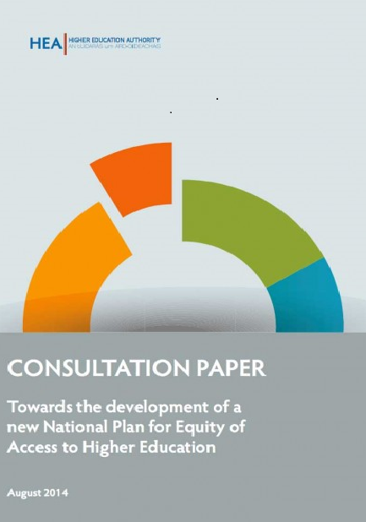
Consultation Informed Principles of Plan
Access policies must span the education spectrum
Partnerships between stakeholders critical: HE, schools
Key role of teachers and teacher training
Pathways from further education need to be improved
Funding needs to be configured to improve access and completion
Need for better data to inform policy & practice

Slide 7
Mainstreaming access in higher education institutions
New System Performance Framework, 2018-2020
Strategies supporting student success
Programme for Access to Higher Education (PATH)
Strand 1: Access to initial teacher education

Slide 8
Building pathways and developing partnerships
Regional clusters and local partners
PATH Strand 2 (1916 student bursaries)
PATH Strand 3 (Higher Education Access Fund)
Centres for teaching excellence (PATH 1)
Development of alternative routes e.g. HEAR/DARE

Slide 9
Assessing the impact of current access initiatives
Reviews of funding and infrastructure
Access Data Strategy
System Performance Framework 2018-2020
Mid-term Review of Plan and Targets (2018)

Slide 10
Questions For Discussion
What actions are most helping to increase access?
What more could be done by higher education?

Slide 11
Thank you www.hea.ie access@hea.ie @HEAaccess

