Slide 1
Challenges for the future in Irish second-level education
Emer Smyth

Slide 2
Introduction
Various ways of reflecting on an educational system and its challenges:
Assessing it in terms of external benchmarks (e.g. PISA)
Using internal benchmarks (e.g. changes in retention)
Listening to stakeholders and practitioners
Listening to students themselves

Slide 3
Student voice
Increasing focus internationally on the value of taking account of the perspective of children and young people in research/evaluation, service design and delivery, and policy development
Value of listening to students:
Its capacity to strengthen pupils’ commitment to learning and to contribute in realistic and exciting ways to school improvement. (Rudduck and McIntyre, 2007)
Focus on challenges raised by student perspectives on their education (drawing on the Post-Primary Longitudinal Study)

Slide 4
Background to the study
The first longitudinal study exploring students’ experiences in Ireland
Cohort of 900 students in 12 case-study schools
Surveyed from 1st year to 6th year plus group interviews with students
Follow-up of individual early school leavers
Survey of, and interviews with, parents
Followed up 3-4 years after leaving school (Leaving School in Ireland study)
Unique insights - capture the student voice but multiple perspectives (principal, key personnel, parents)

Slide 5
Three aspects of student experience
What is good teaching? What helps students learn?
School climate: the nature of teacher-student relations
Schooling as preparation for the future

Slide 6
1. What is good teaching? Teaching methods
Clear explanation
If they explain things well enough for the student to understand.
If they have a second way of explaining it maybe; if you didn’t get it the first way, they can tell you the second way. (Hay Street, coeducational school, working-class, LC)
Preference for active learning, fun
I remember the [teacher] came in and she had like, not games but … I think that stuck in my head more.
Like cards, like a picture and the French underneath.
It's more like fun to remember, when you do it in a fun way.
(Harris Street, girls’ school, middle-class, JC)
Being allowed to express opinions; interactive

Slide 7
What is good teaching? Teacher qualities
Enthusiasm for the subject
Respect
A caring environment
An orderly environment
[A good teacher is] One that actually cares about the students, whether or not they do well in their exams as opposed to just going in for the forty minutes, teaching and then leaving.
Yeah, they have to have patience as well.
(Fig Lane, coeducational school, middle-class, LC)

Slide 8
What is bad teaching?
Didactic methods; reading from a book
Lack of respect for students
I don't know, she [the teacher] doesn't explain things, she just kind of puts it there and do it, do it and that's it, she doesn't explain it, it’s like do it and you’re just sitting there looking at it and then she gives out to you.
(Dixon Street, coeducational school, working-class, JC)
Because when they give out to you, you can't concentrate, well I can't.
Because when a teacher gives out to you you're in a fuss then with them and then you can't just sit there and concentrate then after that … You just won't work for them because they're roaring at you. (Barrack Street, girls’ school, working-class, JC)

Slide 9
Pace of instruction (junior cycle)

Slide 10
Teaching in the exam years
Junior Cert students contrast ‘good teaching’ (clear explanation, making learning fun and more student involvement) with the exam focus in 3rd year
You used to do fun things in class, they'd come in and say let's play games. If you say it this year you get like stared at, what do you think you are?
It relates to everything, the exams, you're doing your Junior Cert you shouldn't be talking, you'll miss out on stuff.
(Harris Street, girls’ school, middle-class, JC)

Slide 11
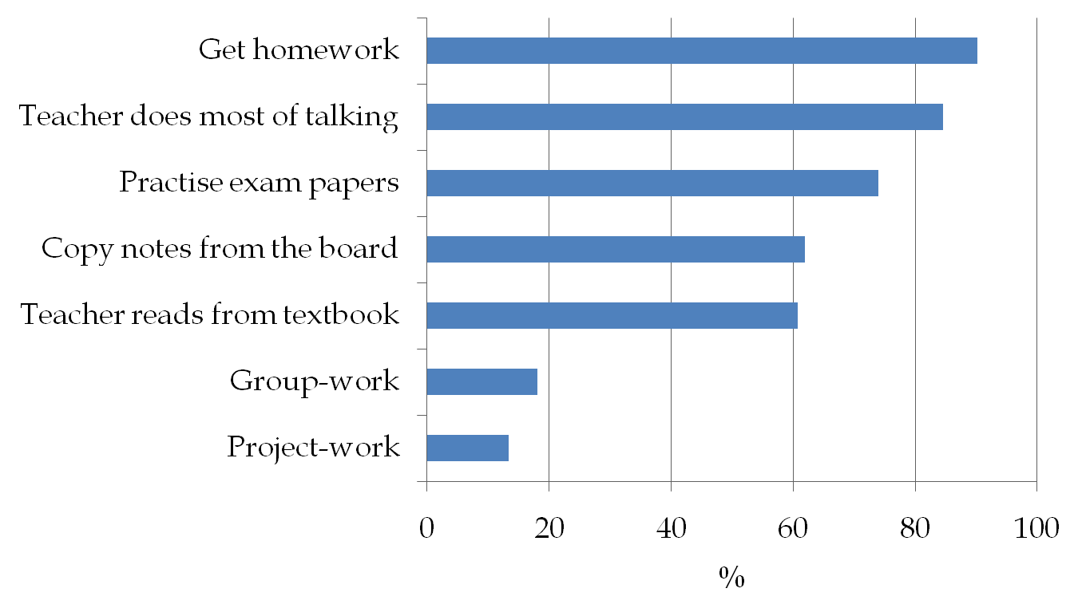
Teaching methods in sixth year (% ‘every/most classes’ for LCE/LCVP)

Slide 12
Views of learning: LC
By 6th year, many view teaching to the test as a signal of a good lesson
For many Leaving Cert students, good teaching is preparation for the exam
This is more evident for middle-class students with high aspirations
Like some teachers kind of go off the point sometimes and just waffle on about pointless things that isn’t on the course and stuff. (Fig Lane, middle-class coeducational school, LC)
Like my Home Ec teacher, she comes in and she knows how to cook, she tells us all about how to make mayonnaise today. That’s not on our course, we don’t care.
(Harris Street, middle-class girls’ school, LC)

Slide 13
Grinds and exam preparation
Over ½ of 6th years were taking ‘grinds’; varied by gender and social background
Like in Maths, they go straight to the thing that you have to do for the Leaving Cert, rather than going through all the stuff that you don’t have to do, that you don’t really need to know.
(Park Street, mixed intake boys’ school)
They’re so exam based and … you just know that you’re learning the right stuff, so I find them real helpful.
(Fig Lane, middle-class coeducational school)

Slide 14
2. School climate Changes in student-teacher relations

Slide 15
Liking school and teachers

Slide 16
Student disaffection
Emerging dynamic of ‘giving out’ and ‘acting up’
Negative interaction increases more in working-class schools and in lower streamed classes
School drives you mad, it actually would, the teachers, if you'd better teachers there would be no one getting in trouble.
When you come back at the start of the year you’re alright for a while.
You calm down but then it starts building up through the year because you’re so bored of school and you want to get out of it. (Lang Street, working-class boys’ school, middle stream class)

Slide 17
Impact of school climate
School completion: negative relations with teachers a dominant theme in early leaver accounts
I hit third year and I just started not getting on with the teachers and all. I kept getting thrown out of classes and suspended all and I just hated it and I hate that school. (Elaine, Dixon Street, Senior Cycle Leaver)
The teachers say stuff to you like, you know kind of put you down … so then you feel like oh I haven’t got the teacher on my side, they don’t want to teach me so like, is there any point being here at all. (Eric, Argyle Street, Senior Cycle Leaver)
Educational achievement: negative interaction and underperformance
Personal and social development: stress levels; self-image, including capacity to cope with schoolwork

Slide 18
3. Student views of the benefits of second-level education (% ‘a lot’)

Slide 19
Benefits: friendship
Your friends and that would be the only thing you'd take out of it. (Belmore Street, mixed girls’ school)
At least you have something to look back on, at least you had a bit of a laugh with your friends.
(Park Street, mixed boys’ school)
You accept people, you’re really together in your class and there’s so many different types of people in our class.
It’s good to be able to get on with them.
(Harris Street, middle-class girls’ school)

Slide 20
Benefits: ‘education’
Just learning about the subjects we did.
A broader knowledge.
Like general knowledge.
(Dawson Street, mixed coeducational school)
I think I’ve been lucky with teachers that and subjects I did, I’ve had quite a good education here. Even though there’s one real bad teacher I’ve had fairly good education.
(Wattle Street, mixed boys’ school)
That’s about it, the Leaving Cert. (Park Street, mixed boys’ school)

Slide 21
Benefits: work/life skills
You’re around people and it’s kind of like being in a work place, you’re around talking to people and learning things.
I suppose you just learn to obey rules, like not coming in late and get yourself prepared for a job.
(Park Street, mixed boys’ school)
Value of work experience; but access depends on the programme taken

Slide 22
Student views on the gaps in second-level education: preparation for college/work
Job things, work experience should have been part of 6th year … maybe at the start of 6th year to see what jobs, even in 5th year, to see what jobs you might like to do.
(Fig Lane, middle-class coeducational school)
Just to tell us a bit about what
What college is like and all that.
Yeah, what college we can go to, what we can do after college. (Dawson Street, mixed coeducational school)

Slide 23
Gaps: preparation for adult life
[School ] prepares you for college and that’s where you learn for your adult life.
You're only prepared for the education side of college.
(Harris Street, middle-class girls’ school)
Some teachers will prepare you about like what life is going to be like on your own and all that but most of them are just going on about the basic subjects … they are not preparing us for going out and just working and living on your own and coping with things. (Barrack Street, working-class girls’ school)

Slide 24
Transition to further/higher education

Slide 25
Main challenges in first year of ET

Slide 26
Shift to self-directed learning
Challenges of knowing what standard to expect and course difficulty; ‘dealing with deadlines’
In school you’re learning for an exam, in college you’re learning to think for yourself, it’s just completely different. I don’t think school really prepares you for it. (Sandra, Belmore Street, higher education)
There’s a lot of self-directed work compared to being in secondary school where you’ve got someone always behind you and saying, pushing you like ‘you know you have to do this, you’re in sixth year, your Leaving Cert is coming up’. (Fiona, Barrack Street, higher education)

Slide 27
Conclusions
Listening to student perspectives can contribute to policy development (national/school levels)
Challenges:
Respond to students’ views on good teaching
Foster positive school climate
Help prepare students for the future (in a broad sense)

Slide 28
Teaching and learning
Student views on good teaching are not always reflected in reality, especially in exam years
Current mode of assessment is impacting on young people’s view of learning
Potential of junior cycle reform to provide space to use more diverse methods; implications for senior cycle
Challenge – supporting change in teaching and learning to promote student engagement; role of teacher development and peer support

Slide 29
School climate
Positive social climate: initial and continuing teacher education; school development planning
Positive behaviour policy; student involvement in school life

Slide 30
Preparation for the future
Broad perspective: preparation for lifelong learning, work and adult life; but also continued engagement with valuable forms of knowledge
Work experience:
Access depends on senior cycle programmes taken
Career sampling v. ‘job’
Role of project work at junior and senior cycle
Whole-school and specialist guidance throughout second-level education; especially important for disadvantaged students and schools

