Slide 1
Recent TUI Research
David Duffy
NUI Maynooth, January 31st 2015

Slide 2
CPD – Survey 2014
83 responses
Three-quarters of the responses gathered in September 2014
Responses gathered through survey monkey

Slide 3
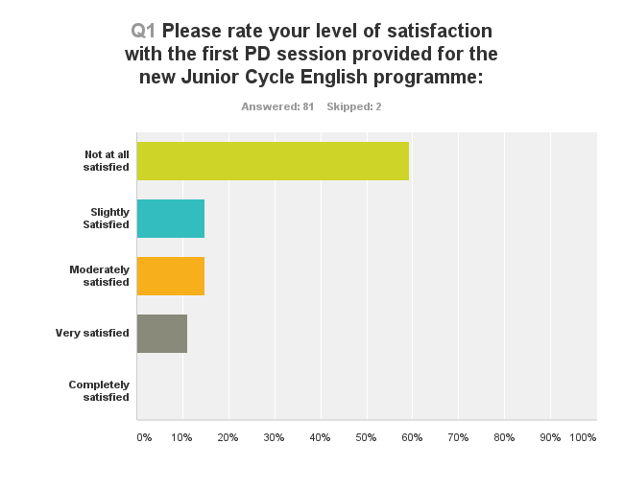

Slide 4
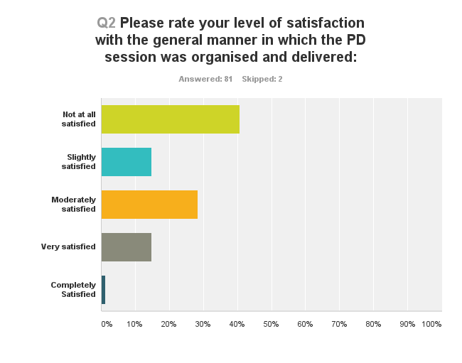

Slide 5
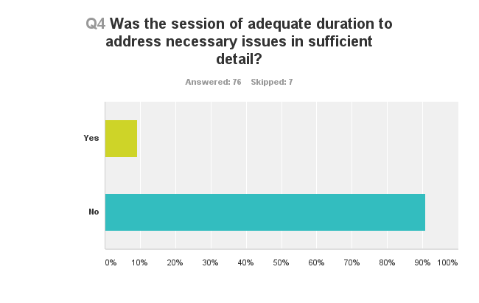

Slide 6
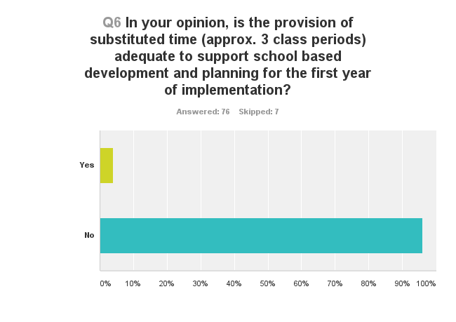

Slide 7
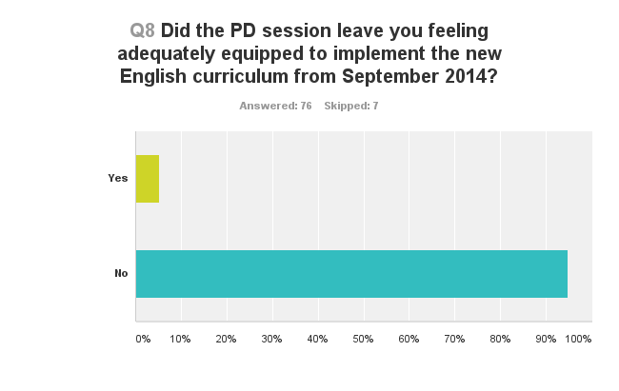

Slide 8
Comments on CPD Survey
Considerable level of frustration with CPD
Significant sympathy for those charged with delivering CPD
Genuine and widespread concern about ability to confidently deliver programme

Slide 9
Guidance Support– Survey 2014
125 responses
Almost 90% of the responses were gathered in March 2014
Responses gathered through survey monkey

Slide 10
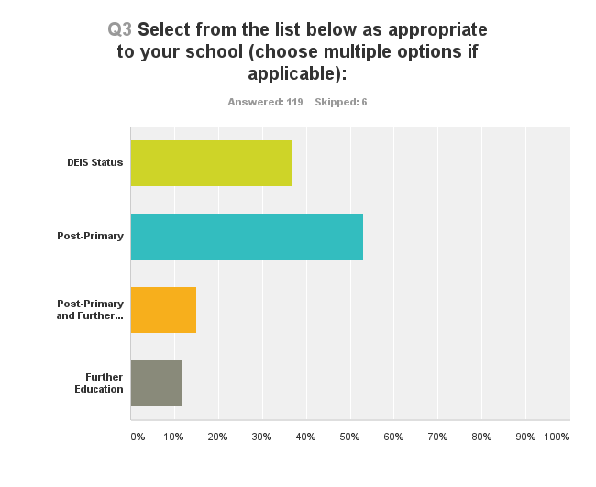

Slide 11
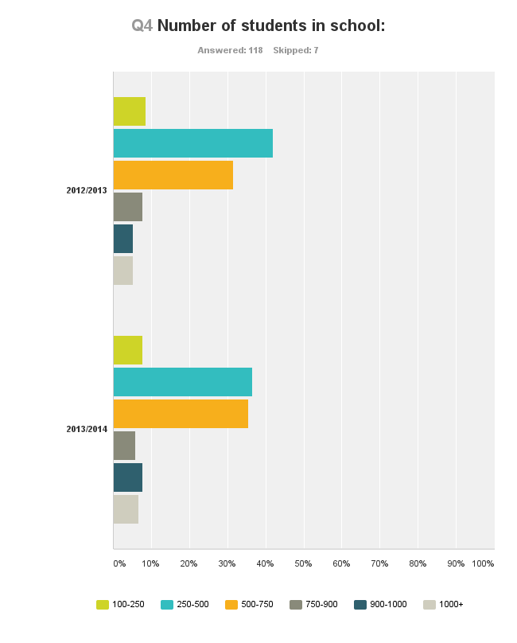

Slide 12
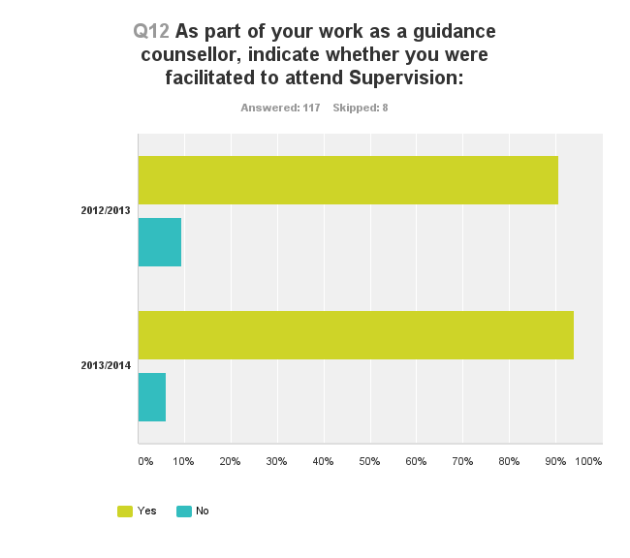

Slide 13
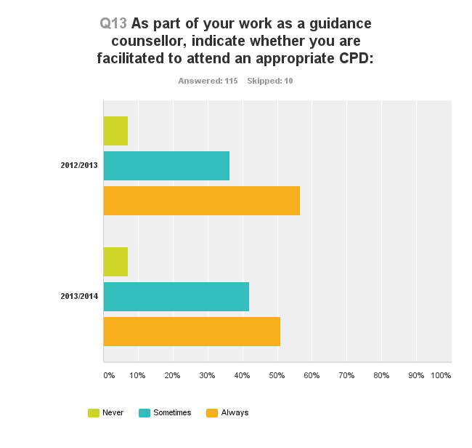

Slide 14
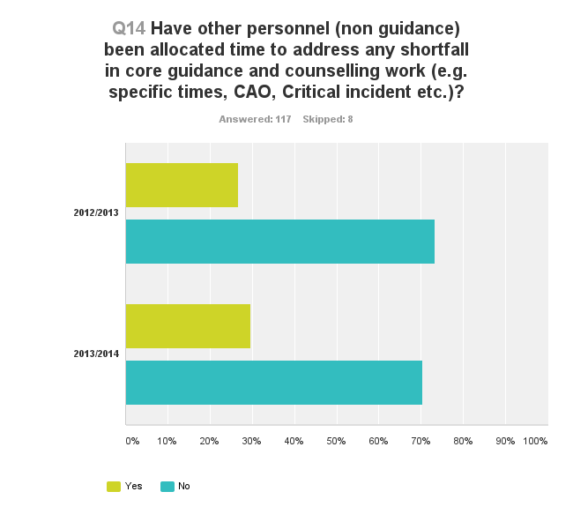

Slide 15
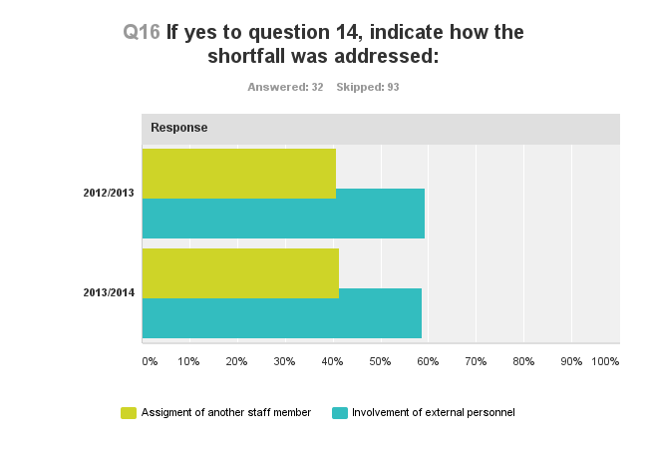

Slide 16
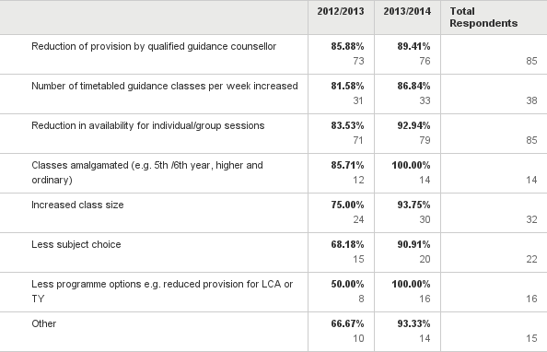
How has provision of guidance and counselling within quota been managed in your school (please tick all that apply)?

Slide 17
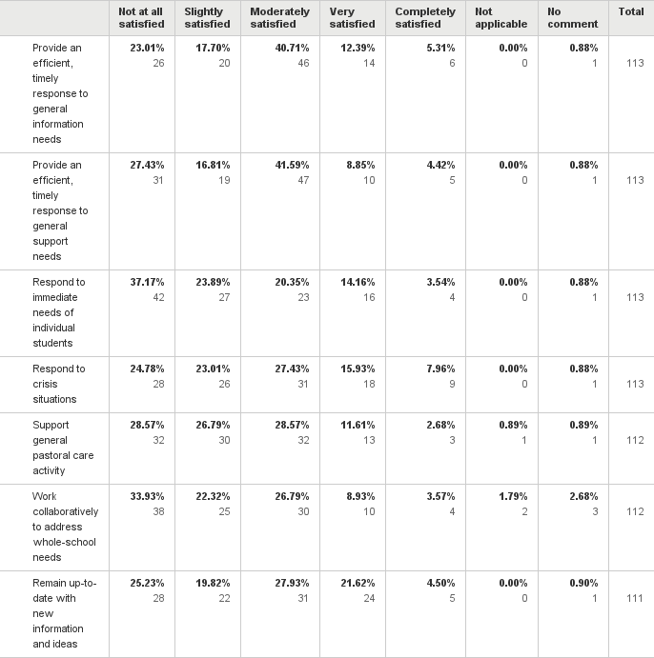
In the context of the provision of guidance and counselling within quota, rate the capacity of the guidance and counselling team (qualified guidance counsellors) to:

Slide 18
Comments on Guidance Survey
Comparisons with previous year interesting
Guidance counsellors find school management very supportive but what about Government?
Increase in number of non-guidance personnel, and external personnel, delivering guidance support
Greater difficulties for guidance counsellor in reacting to crisis situations and one-to-one/small group support
Significant concerns about the ability to cater for pastoral care needs through one-to-one or small group support

Slide 19
Any questions?

