Slide 1
College For Every Student (CFES) is a nonprofit organization committed to helping underserved students get to and through college, and ready to enter the workforce.
BALBRIGGAN COMMUNITY COLLEGE

Slide 2
The vision
WHO GOES TO COLLEGE?
ONE MILLION MORE

Slide 3
CHAMPIONS OF CHANGE
TRINITY ACCESS PROGRAMMES
RIPPLES OF HOPE
CFES/US
SCHOOL TEAM
STUDENT COHORT

Slide 4
Core Practices:
Mentoring
Leadership Through Service
Pathways to College
All of our CFES Schools have access to our modules online that provide resources for each of our core practices!
www.cfes.org

Slide 5
Mentoring
Fosters academic and personal growth
Utilize peers, adults, teachers, community leaders, and/or college students as mentors
Hosts Live Forums, to be accessed virtually

Slide 6
Mentoring showcase Convention Centre

Slide 7
MENTORING LUNCH
COLLEGE MENTORS,SENIOR STUDENTS AND TEACHERS SPEND TIME WITH SECOND YEAR STUDENTS AS PART OF LAUNCH OF MENTORING IN OUR SCHOOL.

Slide 9
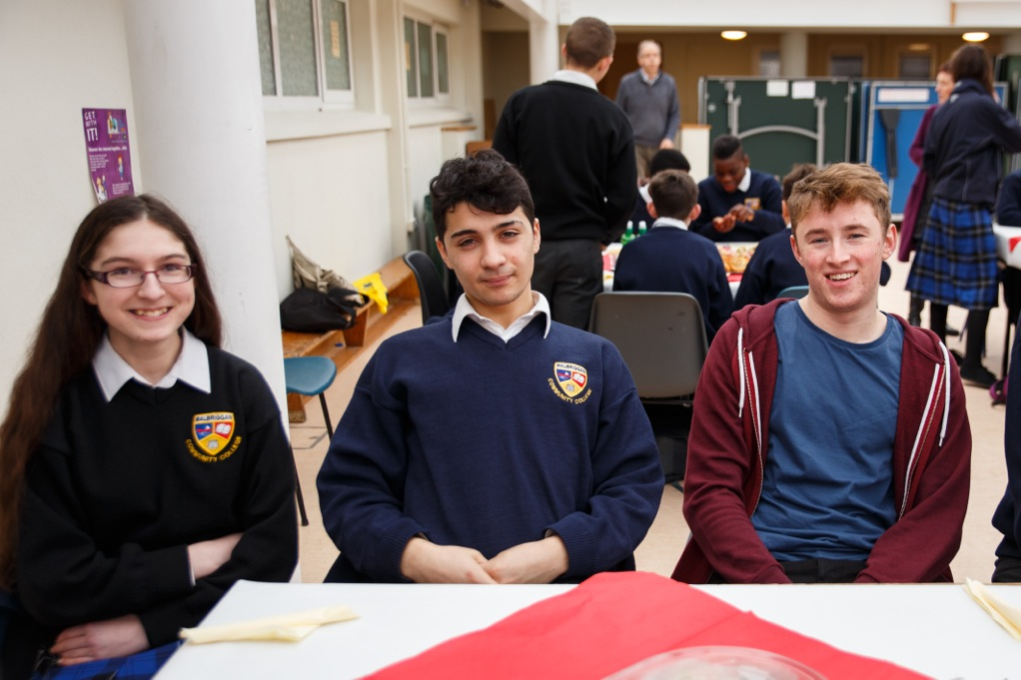

Slide 10
Pathways to College
CFES has partnered with colleges across the US and TCD Ireland
Provides College Visits
Educates the scholars on applying to, paying for, and attending college
BCC Second and Third year students attend careers fair.
SECOND YEAR
DREAM TREE

Slide 11
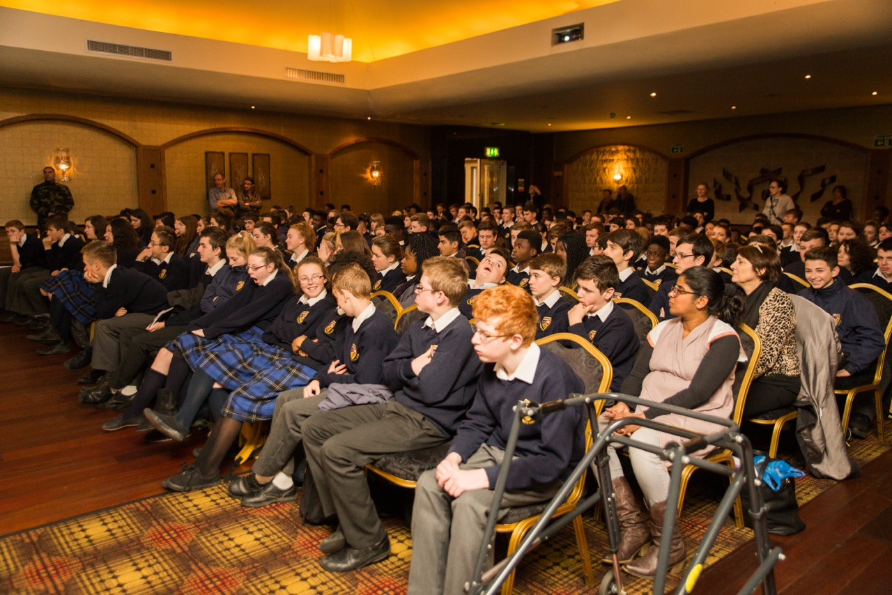

Slide 12
Pathways to college
Solicitor Youth worker
Veterinary Guard
Aviation industry Defence forces
Working in sport
Computing
Working with Google
Science and Food

Slide 15
Leadership Through Service
CFES schools create meaningful opportunities for Scholars to provide leadership in service to others.
CFES Scholars identify and express their leadership potential
Gain leadership skills and take responsibility for others
Encourages personal aspirations for college and developing resilience that leads to college success.

Slide 17
The impact CFES AND TA21

Slide 18
OUR GOAL SCHOOL OF DISTINCTION

