Slide 1
Institutes of Technology and the Future of Higher Education
Professor Ciarán Ó Cathain
31 January 2015

Slide 2
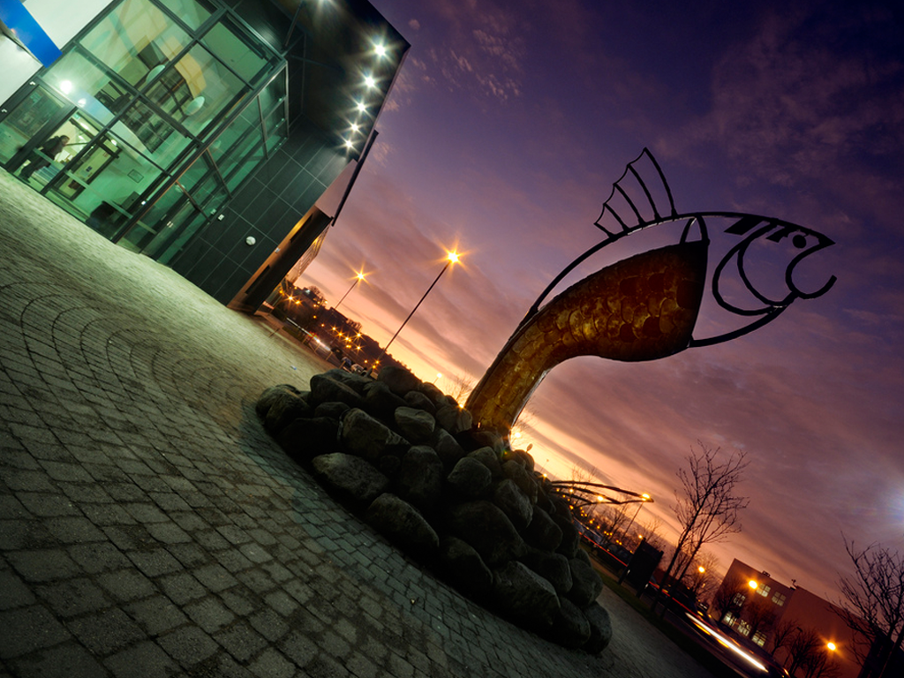
“Great institutions are more than places.
They’re ideas.”
Flora Biddle, Whitney Museum
Notes:
The Whitney Museum of American Art is one of the great institutions of New York, and Flora Biddle served as president until 1985.
A great HEI nurtures the interplay of ideas, people, and place in ways that serve them all. This is the role that IoTs have been fulfilling over the past 45 years.

Slide 3
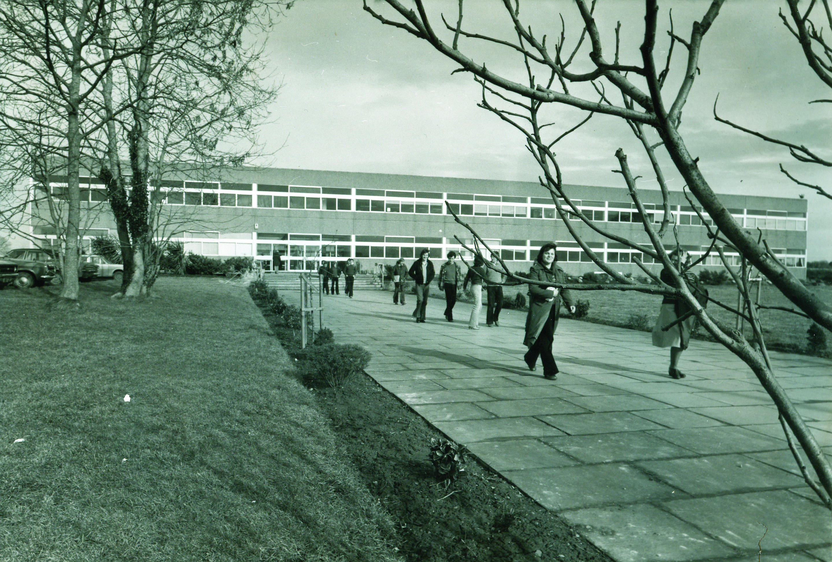
Numbers of new entrants to HE has
grown from 15k in 1980 to 42k in 2013
Currently 210,000 students in HE
41% of whom are in IoTs
Numbers are forecast to grow by 25%+ by 2030
Notes:
The expectations behind the establishment of the RTCs were modest, with the original buildings constructed in such a way that they could be converted into manufacturing units if the experiment didn’t take. However, the focus on preparing work-ready graduates proved to be a successful formula, and today IoT graduates are to be found leading and working in companies and organisations throughout the world.
As the RTCs grew in number, so too did their scope and remit, extending beyond the traditional focus of training technicians to the current situation where institutes of technology offer training from further education level all the way through to PhD and post-doc work. With access to higher education in the regions, third level moved from being the preserve of the few to a real option for all.
The access agenda continues to be central to the mission of IoTS, not just in a geographic sense, which has now been extended through the provision of online education and MOOCS, but more critically in providing a location where first generation college students could feel at home, and those coming from challenging situations were afforded all the support necessary to achieve their true potential.
The current progression rate from second level to third level is 56% and it is expected to remain at this rate for the foreseeable future. The massive increase predicted over the next 15 years is purely as a result of the recent baby boom.

Slide 4
Nature of provision
Significance of access to non-traditional groups
50% of IoT acceptances in 2014 CAO were from non-Leaving Cert cohort; in universities it was 27%
44% (35,000) of undergrads in IoTs were registered on Level 6/7 in 2012/13
18% of full-time new entrants were mature students in IoTs – double that of universities
Notes:
While there has been talk of mission drift within the IoTs, the evidence tells a different story in terms of the students the institutes attract and the nature of programme delivery.
While the recession hit all sectors of society hard, when it came to looking for a solution in terms of retraining and upskilling, mature students turned to the IoTs in their thousands. Whether it was former plumbers and plasterers now training to be electronic or mechanical engineers, production line workers seeking to become social care workers, the IoTs were the colleges of choice.
This has had a profound impact in terms of college life, with 17- and 18-year-olds now studying with and working in project groups with people who are their parents’ age. The benefits for all parties are considerable, with the fresh ideas of youth and the experience of age combining to powerful effect.

Slide 5
Relationship with further education and training
Growing number of agreements between IoTs and ETBs
Provisions include development and monitoring of specific PLC programmes to be provided by IoTs in conjunction with ETBs
Linkages enhance access and progression opportunities
Enabling modules support students in progressing from ETBs to IoTs
Notes:
Discussion re long-standing agreement with Offaly VEC and now Laois and Offaly ETB. Impact on business studies has been dramatic with an enormpus intake into second year of higher cert programme. However, it has also proven successful in other areas such as science and engineering.
Could also mention here the reformulated apprenticeship model, which traditionally had been delivered in partnership with the IoTs. The proposals to follow the German model, with apprenticeships being offered up to PhD level in fields such as accounting and engineering is at present alien to many Irish ears. At present, there is a call out to all providers looking for feedback and proposals and it is an area in which the IoTs are responding.

Slide 6
Transitions
Commitment to introducing common entry
programmes at Level 8
Review of ‘overly narrow base of entry’ of some
programmes
Assessment underway into grading bands at Leaving Cert
Notes:
There is a balance to be struck in offering common entry programmes that offer broad choices to students upon entering third level and the provision of highly focused offerings. In some instances the collapsing of niche offerings into single common entry programmes proved unattractive to students.
A key criteria however of higher education is that whether someone chooses a broad-based course or a highly focused one, that they acquire sufficient generic skills to enjoy flexibility and mobility in their career. While many Level 6 and 7 offerings could be classified as niche, ultimately they provide a pathway to students to follow a holistic approach to education.

Slide 7
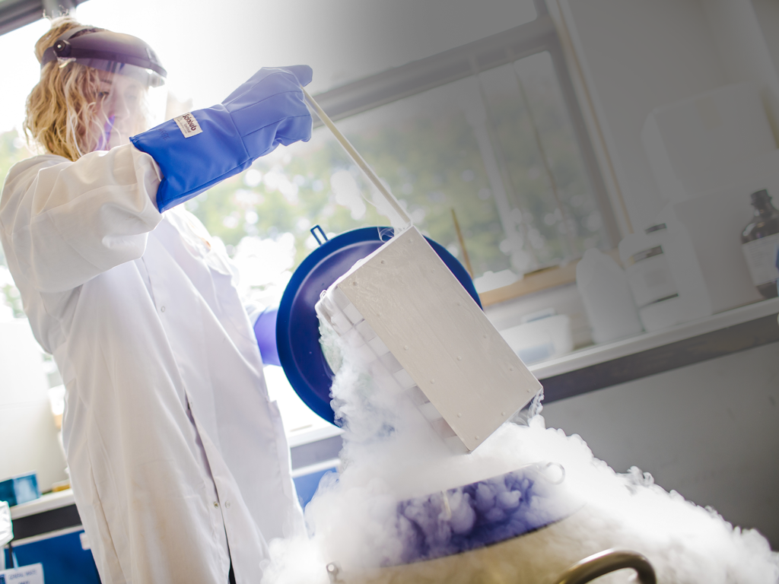
Drivers of Employment
Ireland has the highest rate (53%) of tertiary attainment amongst 30-34 year olds in the EU and third highest in the developed world
Local concentrations of high-skilled workers helps create five times the number of jobs in other activities
Notes:
Such a skilled labour force has enabled IDA Ireland to sell Ireland internationally and secure foreign direct investment. Companies like PPD, Boston Scientific and countless others have acknowledged the importance of a highly qualified workforce in the regions as being central to their decision to locate there.

Slide 8
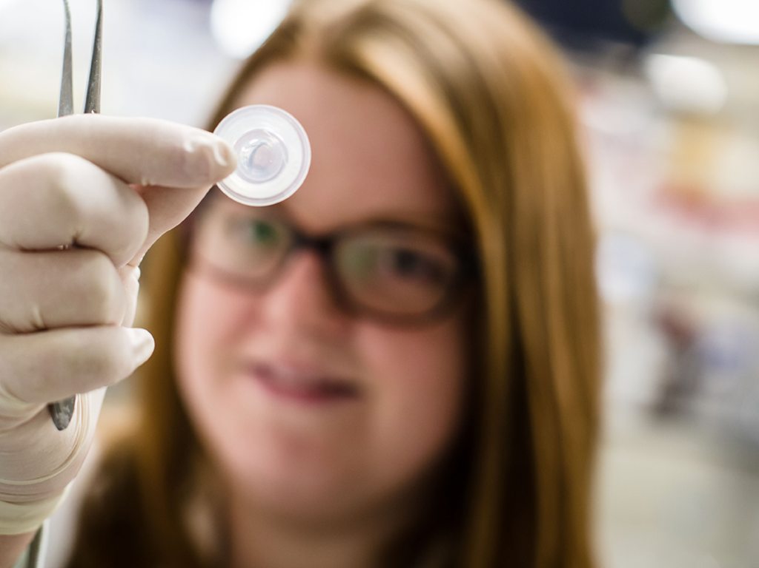
Research, Innovation & Entrepreneurship
Applied industry-focused research benchmark of IoTS
300 spin-outs and spin-ins supported by IoTs
500 new jobs created with support of RI&E activities of IoTS
1000+ students undertaking research at L9/10
520 staff engaged directly in RI&E activities

Slide 9
g
WIT spin-out FeedHenry sold for €63.5m – 70 employees
Notes:
FeedHenry was a spin-out from TSSG at WIT. The firm develops mobile internet technology that allows big companies to create specialist mobile applications. Experts estimate that value of the mobile apps market would grow to €28bn by 2015.
FeedHenry makes 'cloud mobile application platforms' for big companies. This serves organisations that can't make do with general apps available for the general public, who turn to Feedhenry for high-end, specialised tools to let companies develop their own solutions.
“As mobile devices have penetrated into every aspect of enterprise computing, enterprise software customers are looking for easier and more efficient ways for their developers to build mobile applications that extend and enhance traditional enterprise applications. FeedHenry will help us enable customers to take advantage of the capabilities of mobile with the security, scalability, and reliability of Red Hat enterprise software."

Slide 10
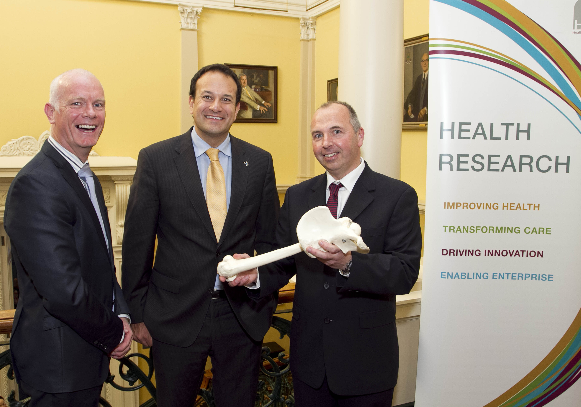
New Treatment for Pneumonia
€300k AIT research project funded by HRB
Research will use novel combination of adult stem cells and magic mushrooms to see if they can help the immune system fight pneumonia infections
Notes:
AIT research project which could lead to the development of a treatment for pneumonia, was today announced as part of a €13.5m package in health research funding by Minister for Health, Leo Varadkar TD.
Prof Neil Rowan from Athlone Institute of Technology and collaborators from NUI Galway will conduct research using a novel combination of adult stem cells and medicinal fungi to see if they can help the immune system fight pneumonia infections. The researchers hope the result could, in the long term, help introduce an alternative to antibiotics.
This Health Research Board-funded project (€278,000) will target bacterial pneumonia that is the most common cause of acute lung injury and acute respiratory distress syndrome, which effect 19% of intensive care patients in Ireland.
According to Prof Rowan: “While there have been staggering advances in medicine, pneumonia is still a common disease in Ireland accounting for approximately 5% of deaths and it is the most frequent cause of deaths worldwide. With increased use of invasive surgical processes and immunosuppression, the incidence is likely to increase in the years ahead. There is therefore a pressing need to develop novel therapies as described in this HRB project to treat these respiratory diseases.

Slide 11
s
s
Notes:
Simply a link slide to allow you to go from all these stories of success to recognising that recent years have been very challenging.

Slide 12
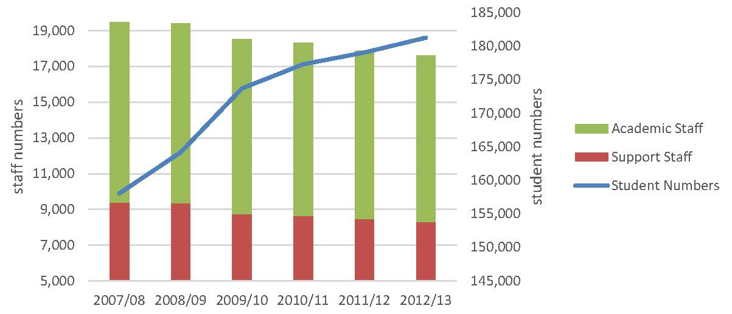
Staff and Student Numbers 2007-2013
Notes:
While the successes of the IoTs have been notable, recent years have proven an exceptionally challenging environment with diminishing budgets, recruitment embargoes, growing student numbers, and a far greater mix of students thereby imposing a great burden on already challenged resources.

Slide 13
Funding Crisis in HE
While the student contribution charge has increased by 233% from 2007/08 to 2014/15, the total income per student fell by 22%

Slide 14
HE Landscape
Technological universities
Regional clusters
Engagement

Slide 15
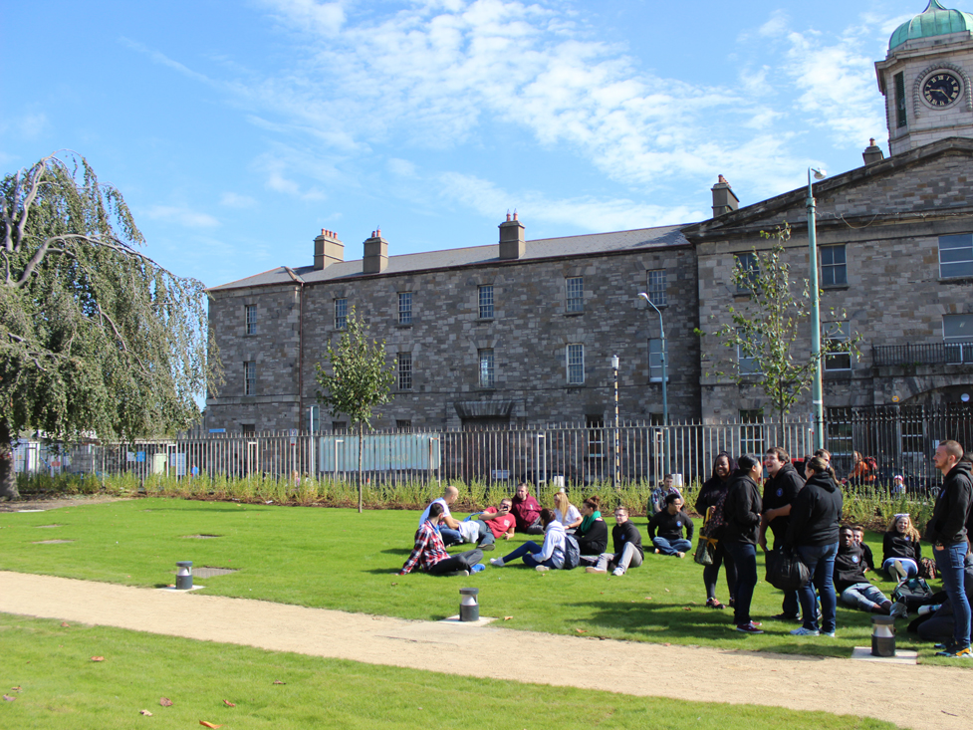
Technological Universities
Higher education landscape to comprise coherent system of mission-diverse, complementary, and highly collaborative institutions characterised by diversity and high quality performance
Notes:
“More than ever, we need a technological sector that is agile and responsive to not only the skills needs – but also the research and development needs – of a rapidly changing enterprise sector, and an increasingly diverse workforce.” – Ruairí Quinn – 2012
Issue of public confidence in our sector is vital. IoTS cannot afford creation of perception of multi-tiered system
Important to make the point that the process of becoming a TU is one wholly rooted in review by expert international panel of quality and other metrics. While the politicians may be pursuing a local or regional agenda, ultimately this is too important an issue to allow political interference.
In parallel with the issue of TUs and mergers is the proposal for all IoTs to be establish all the IoTs as awarding bodies in their own right, thereby recognising the maturation of the system. This would thereby create a more coherent HE system in the areas of QA and qualifications.

Slide 16
AIT context
Strategic plan 2014-2018: Global Focus – Regional Impact
Sets out vision for AIT to become a TU, which will amplify the best aspects of what AIT does; it will enhance reputation, and provide a platform for future growth
Adopting a phased approach – immediate focus is on quality metrics

Slide 17
To merge or not to merge?
“Mergers will strengthen the emerging TU sector, however at the same time the merger formula doesn’t apply in the same way in every situation, simply because every situation is not the same”
“Danger” of mergers is that they create “inflexibility and you can get into a situation where the formula is driving the policy, rather than the policy using the formula as a tool, for achieving a better social and economic outcome”
– Prof Simon Marginson, 2014

Slide 18
Regional Clusters
Regional clusters will be created in a formal and systemic way to address the full range of higher education needs of a region and to advance regional development.
The clusters will also facilitate extensive engagement with other education providers at all levels, as well as with enterprise, business and community stakeholders.
Notes:
From Landscape document:
An immediate priority is to enhance the quality and cost-effectiveness of provision through shared collaborative provision at under-graduate and post-graduate levels, particularly in high cost programmes, such as medicine, engineering and architecture, or programmes with limited student demand. Collaborations and alliances may also lead over time to consolidation, where this can bring academic and other benefits to the HEIs involved and the wider system.
Building on this progress, regional clusters will be created in a formal and systemic way to address the full range of higher education needs of a region and to advance regional development. All higher education institutions will actively participate in regional clusters. Collaborative arrangements between institutes and universities that enhance the quality and effectiveness of their activities are expected, and indeed will in many instances form the nucleus of regional clusters. The clusters will also facilitate extensive engagement with other education providers at all levels, as well as with enterprise, business and community stakeholders.
In addition to regional clusters, collaborations that are not constrained by geography will be vital. These include mission-based clusters to guarantee the continuing provision of labour-market oriented and practice-led specialist provision in areas such as culinary arts, art and design, policing and army, tourism, agriculture, theatre/drama. 9
Collaboration that transcends national boundaries will become increasingly important to enhance the international connectedness and reputation of individual institutions and of the system as a whole.

Slide 19
AIT-Maynooth University collaboration
undergraduate and postgraduate programmes
working towards joint programmes in biotechnology, sport and health science
student access and progression
research
commercialisation and entrepreneurship
internationalisation

Slide 20
Regional Development: AIT/MU collaboration
Entrepreneurship / enterprise development
New Frontiers
Midlands & Mid-East regions
Knowledge / Technology Transfer
TTSI2 Consortium: ‘A - Excellent’ rating in 2014
First joint MU-AIT spin-out company, CaraMagic, in 2013
Structured PG Research Provision
Shared modules
‘Creativity & Entrepreneurship’
Notes:
Caramagic:
The company is developing products for a number of different sectors based on voice changing algorithms that have been licensed to the company. Its first product is a digital puppet app called MagicFriends.
Regional Level (Chapter 8)
Regional structures and functions will be revised and strengthened with replacement of the eight regional authorities and two assemblies by three new regional assemblies to perform an updated range of strategic functions.
The new regions will be as follows:
• Connacht-Ulster Region
• Southern Region (the province of Munster and counties Carlow, Kilkenny and Wexford)
• Eastern-Midland Region (the counties of Leinster other than those in the Southern Region)

Slide 21
Engagement
“Engagement has to be an institution wide commitment, not confined to individual academics or projects. It has to embrace teaching as well as research, students as well as academics, and the full range of support services.” – Goddard

Slide 22
Embedded in IoT Strategies
GMIT
Final year projects centred around problems/challenges sourced from the business and wider communities
Promotion and facilitation of civic engagement modules
CIT
Extended Campus supports two-way engagement between community and CIT for purpose of knowledge exchange, learning & research activities
AIT
Partnership, collaboration and scholarship with industry to become a centre of excellence and influence in areas of growth in the Irish economy with particular emphasis on regional developmental opportunities.

Slide 23
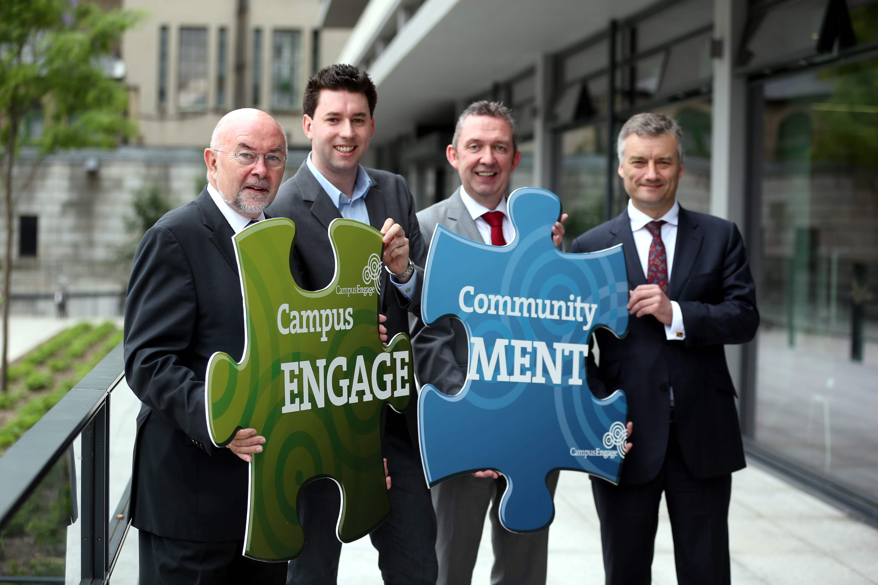
Notes:
In June 2014 10 point Campus Engage Charter on Civic and Community Engagement launched by Ruairí Quinn.
Under the Charter presidents of HEIs underscore their commitment to the civic and community engagement role and responsibilities of their institutions. Launching the Charter, Minister for Education and Skills, Mr. Ruairi Quinn T.D said, “Today is an important recognition of commitment by Ireland’s higher education institutions to build on what has been achieved to date and place Ireland at the fore internationally in terms of promoting civic and community engagement by higher education. The importance of ‘engagement’ is recognised in the National Strategy for Higher Education to 2030, and in the HEA’s performance framework, which both ask higher education institutions to engage openly with their community and wider society and for this to infuse every aspect of their mission. I congratulate all involved in the realisation of the Charter, and specifically to the Presidents for their commitment.
“ The launch of an Irish Charter for Civic and Community Engagement builds on the pioneering actions taken by other countries including Australia, UK and the US, who have signed up to similar agreements at national level to support and strengthen the civic role and responsibilities of higher education.

Slide 24
“Education is our passport to the future, for tomorrow belongs to the people who prepare for it today.” ― Malcolm X
Notes:
Wrap-up slide with which to point to the fact that we’re living in very exciting and challenging times. The role of IoTs is expanding to become one of knowledge generator, innovation partner and community collaborator.
The path by which we reach our goals will have a major bearing on the success of this venture. In that, partnerships between educational and research stakeholders and the generation of a shared vision will be key.

Slide 25
Thank you

